Slide 1

Ginger Team COSC 3765/5010 Final Project Alicia Thoney and Addie Reichert
Notes:
Addie

Slide 2
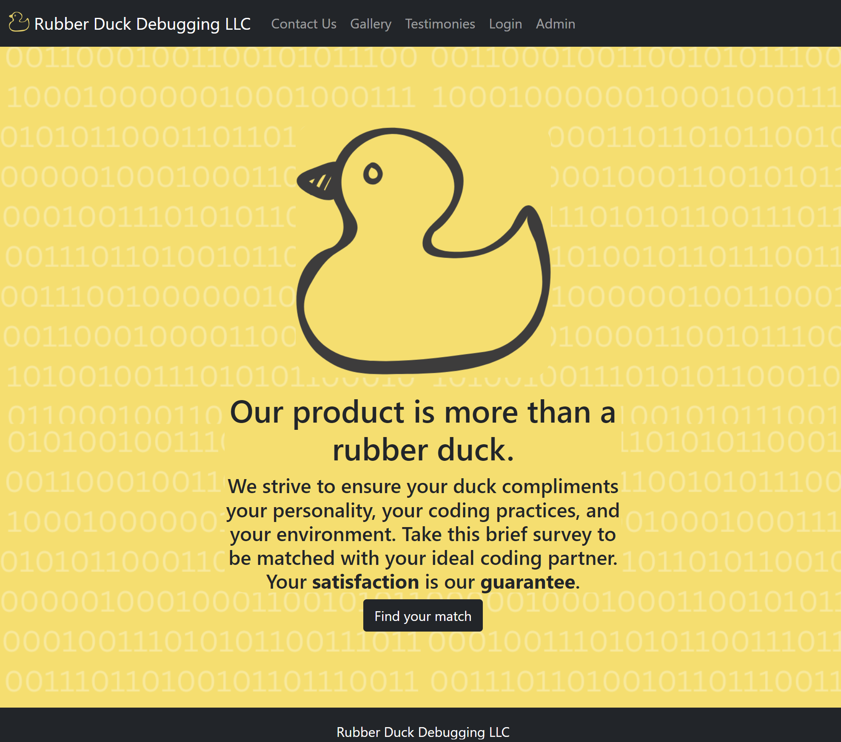
Overview of Labs Selected
SQL Injection Attacks
Webpage creation
Database creation
Data cleansing
Password storage/hashing
Why: web development + security concepts
Notes:
Addie

Slide 3
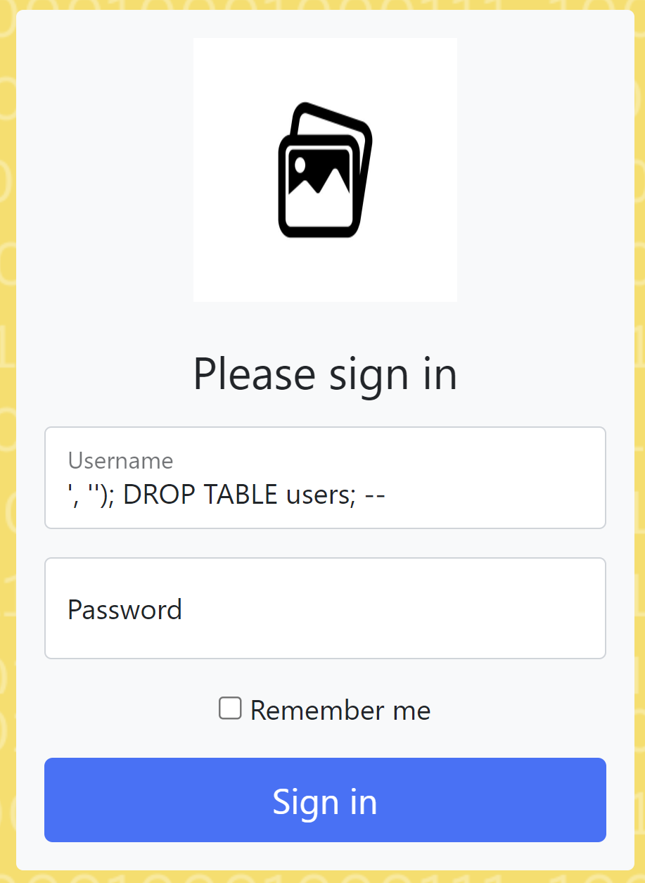
Accomplishments
Created two company websites- a vulnerable and a secure site
Using a Go and SQL backend
Vulnerable page:
Lets you drop the users and contacts tables from the front end
Stores passwords as plaintext
Secure page:
Implements Go’s database/sql library’s functionality for safe sql query parameter passing
Stores passwords as hashes
Notes:
Addie

Slide 4

Challenges
Challenge: Building SQL injection statements with the correct syntax
How to Overcome: Thinking from the perspective of an attacker and thinking about the greater context that the user information is getting inserted into
Challenge: Getting our site and database to work for both of us across both Linux and Windows
How to Overcome: Just patiently work through all the problems and errors of installing software on each machine and Googling as errors came up
Notes:
Alicia

Slide 5
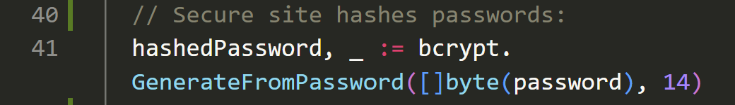
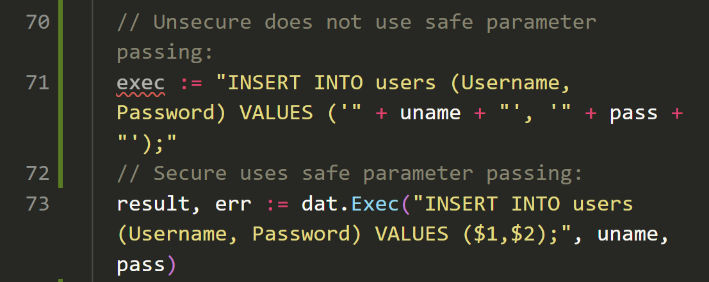
Lessons Learned
What we learned:
Go’s database/sql library implements data cleansing easily via parameter passing
Data cleansing is an “easy” thing to guard against
Our advice:
In whatever language you’re coding in, if you are accepting data from the user, check to see if there is built-in functionality for data cleansing that you can easily implement
Applications to the workplace:
A higher conscientiousness of how easy it can be for an adversary to exploit a vulnerability in a website whenever they have the opportunity to enter information
The knowledge that safe parameter passing is built-in in many languages/sql libraries
Notes:
Alicia

Slide 6

Vulnerable site
Secure Site
Live Demo!

